Slide 1
CSE 12 Week 10 Discussion
12-8-20
Focus: Final Review

Slide 2
Reminders
PA8 (open!) due Thursday, December 10th @ 11:59 PM
No resubmission
PA7 Resubmission due Friday, December 11th @ 11:59 PM
Final: Starts Wednesday December 16th (No-Fault)
CAPES is open!

Slide 3
Midterm 1

Slide 4
Midterm 1
Topics Covered
Testing
Interfaces
Generics
Lists: ArrayLists, LinkedLists
Stacks and Queues
BFS & DFS

Slide 5
Midterm 2

Slide 6
Midterm 2
Topics Covered
Time Complexities
Sorting
Maps and HashTables
Midterm 2 Review Discussion Slides

Slide 7
Beyond

Slide 8
Beyond
Topics Covered
BSTs
Heaps
Improving Lists
Iterators
Streams

Slide 9
What would you like to focus on?
Midterm 1 material
Midterm 2 material
Beyond material
Practice Questions

Slide 10
Binary Search Tree (BST)
Binary Tree
Each node has at most 2 children (left child, right child)
Node Class
Key
Value
Left child
Right child
BST
Nodes belonging to the Left subtree have keys less than the parent node key, and nodes belonging to the right subtree have keys greater than the parent node key
class Node<K,V> {
K key; V value;
Node<K,V> left, right;
public Node(K key, V value,
Node<K,V> left, Node<K,V> right) {
this.key = key;
this.value = value;
this.left = left;
this.right = right;
}
}

Slide 11
BST Traversal
Methods to Navigating a BST
Inorder
Preorder
Postorder
Week 9 Discussion Slides

Slide 12
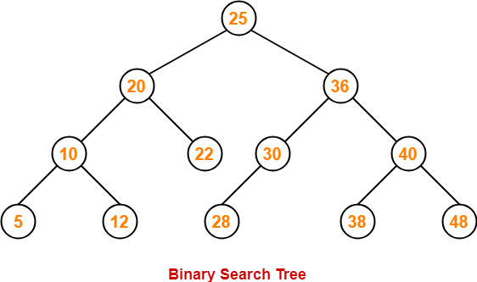
Helpful Terminology
Root: the top node in the tree
Leaf: a node with no children
Breadth: the number of leaves
Depth: the distance between a node and the root
Level: 1 + depth
Subtree: a tree of node T and all of its descendants
Edge: the connection between one node and another

Slide 13
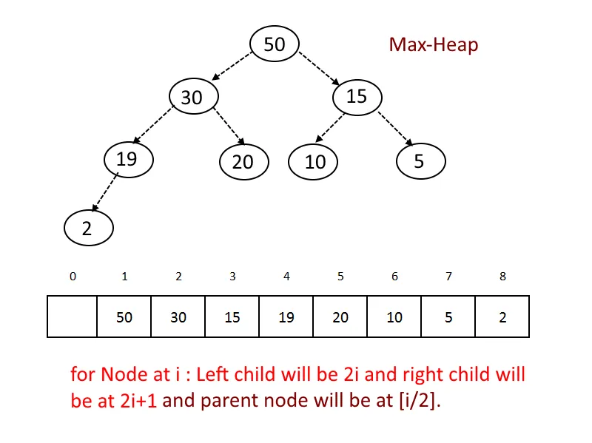
Heaps
A heap is a complete tree implemented with a List
(Know the difference between complete and full tree)
min/max heap
useful when we care about the next largest/smallest value

Slide 14
Bubble Down
Used for deleting an element from the heap
Take last element of heap and put it at the index of the element to be deleted
Check and Swap
Min-heap: if replaced element > any child node, swap element with the child that is smaller
Max-heap: if replaced element < any child node, swap element with the child that is greater
Keep repeating till conditions are not met

Slide 15
Bubble Up
Used for inserting an element into the heap
Insert element at the last leaf of the tree
Check and Swap
Min-heap: if inserted element < parent node, swap element with parent node
Max-heap: if inserted element > parent node, swap element with parent node
Keep repeating till the inserted element is in place

Slide 16
Methods for bubbleDown and bubbleUp
void bubbleDown(int index) {
if(index >= this.entries.size()) { return; }
int leftIndex = left(index);
if(leftIndex >= this.entries.size()) { return; }
int largerChildIndex = leftIndex;
int rightIndex = rigxistsAndGreater(riht(index);
if(eghtIndex, leftIndex)) {
largerChildIndex = rightIndex;
}
if(existsAndGreater(largerChildIndex, index)) {
swap(index, largerChildIndex);
bubbleDown(largerChildIndex);
}
}
void bubbleUp(int index) {
if(index <= 0) { return; }
Entry<K,V> e = this.entries.get(index);
Entry<K,V> parent = this.entries.get(parent(index));
int comp = this.comparator.compare(e.key, parent.key);
if(comp > 0) {
swap(index, parent(index));
bubbleUp(parent(index));
}
else {
return;
}
}

Slide 17
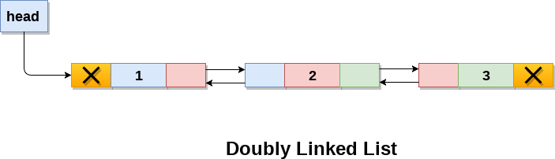
Improving Lists
Circular ArrayList
Doubly LinkedList
start

Slide 18
Iterators

Slide 19
<FILL IN THE BLANK>
public interface Iterable<T>
Implementing this interface allows an object to be the target of the enhanced _________ statement (sometimes called the "_________ _________" statement).
Iterator<T> iterator() Returns an iterator over elements of type T.

Slide 20
<FILL IN THE BLANK>
public interface Iterable<T>
Implementing this interface allows an object to be the target of the enhanced for statement (sometimes called the "for-each loop" statement).
Iterator<T> iterator() Returns an iterator over elements of type T.

Slide 21
<FILL IN THE BLANK>
List<String> lst = new ArrayList<String>();
lst.add("a"); lst.add("b"); lst.add("c");
for(String s: lst) {
System.out.println(s);
}
The highlighted kind of loop only works if that thing (lst) is an _______ or implements the interface _______<T>, _______ are a special case.

Slide 22
<FILL IN THE BLANK>
List<String> lst = new ArrayList<String>();
lst.add("a"); lst.add("b"); lst.add("c");
for(String s: lst) {
System.out.println(s);
}
The highlighted kind of loop only works if that thing (lst) is an array or implements the interface Iterable<T>, Arrays are a special case.

Slide 23
<FILL IN THE BLANK>
public interface Iterator<E>
An iterator over a ________.
boolean hasNext() Returns _______ if the iteration has more elements.
E next() Returns the next _______ in the iteration.

Slide 24
<FILL IN THE BLANK>
public interface Iterator<E>
An iterator over a collection.
boolean hasNext() Returns true if the iteration has more elements.
E next() Returns the next element in the iteration.

Slide 25
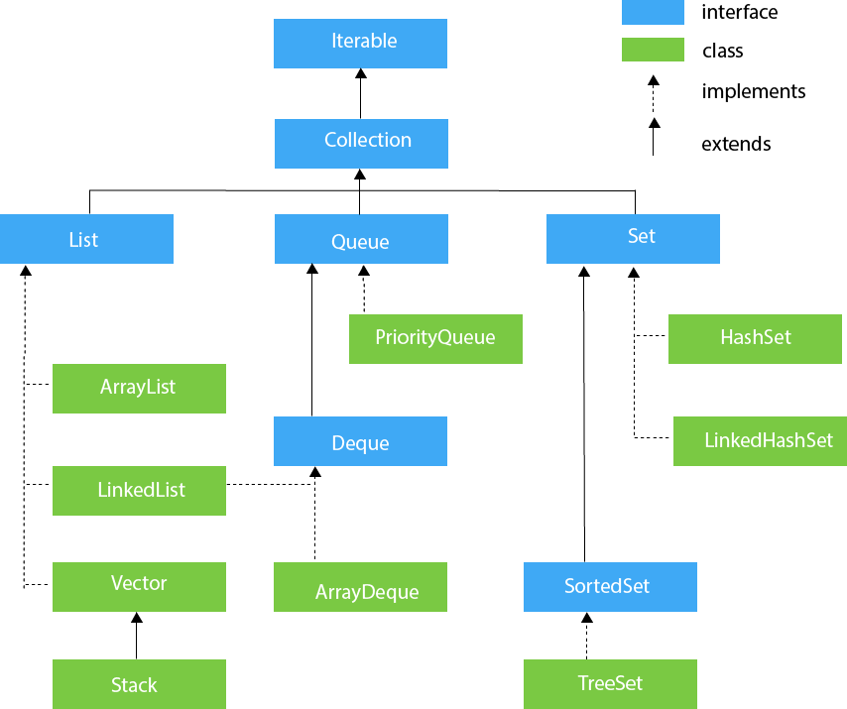

Slide 26
<FILL IN THE BLANK>
List<String> lst = new ArrayList<>();
lst.add(“a”); lst.add(“b”); lst.add(“c”);
// create an iterator from lst
Iterator<String> iter = ___________

Slide 27
<FILL IN THE BLANK>
List<String> lst = new ArrayList<>();
lst.add(“a”); lst.add(“b”); lst.add(“c”);
// create an iterator from lst
Iterator<String> iter = lst.iterator();

Slide 28
What is printed by the highlighted line? (Assume the highlighted line and any lines above have been executed).
List<String> lst = new ArrayList<>();
lst.add("a");
lst.add("b");
lst.add("c");
// create an iterator from lst
Iterator<String> iter = lst.iterator();
System.out.println(iter.hasNext());
System.out.println(iter.next());
System.out.println(iter.next());
System.out.println(iter.next());
System.out.println(iter.hasNext());
System.out.println(iter.next());

Slide 29
What is printed by the highlighted line? (Assume the highlighted line and any lines above have been executed).
List<String> lst = new ArrayList<>();
lst.add("a");
lst.add("b");
lst.add("c");
// create an iterator from lst
Iterator<String> iter = lst.iterator();
System.out.println(iter.hasNext());
System.out.println(iter.next());
System.out.println(iter.next());
System.out.println(iter.next());
System.out.println(iter.hasNext());
System.out.println(iter.next());
true

Slide 30
What is printed by the highlighted line? (Assume the highlighted line and any lines above have been executed).
List<String> lst = new ArrayList<>();
lst.add("a");
lst.add("b");
lst.add("c");
// create an iterator from lst
Iterator<String> iter = lst.iterator();
System.out.println(iter.hasNext());
System.out.println(iter.next());
System.out.println(iter.next());
System.out.println(iter.next());
System.out.println(iter.hasNext());
System.out.println(iter.next());
true

Slide 31
What is printed by the highlighted line? (Assume the highlighted line and any lines above have been executed).
List<String> lst = new ArrayList<>();
lst.add("a");
lst.add("b");
lst.add("c");
// create an iterator from lst
Iterator<String> iter = lst.iterator();
System.out.println(iter.hasNext());
System.out.println(iter.next());
System.out.println(iter.next());
System.out.println(iter.next());
System.out.println(iter.hasNext());
System.out.println(iter.next());
true
a

Slide 32
What is printed by the highlighted line? (Assume the highlighted line and any lines above have been executed).
List<String> lst = new ArrayList<>();
lst.add("a");
lst.add("b");
lst.add("c");
// create an iterator from lst
Iterator<String> iter = lst.iterator();
System.out.println(iter.hasNext());
System.out.println(iter.next());
System.out.println(iter.next());
System.out.println(iter.next());
System.out.println(iter.hasNext());
System.out.println(iter.next());
true
a

Slide 33
What is printed by the highlighted line? (Assume the highlighted line and any lines above have been executed).
List<String> lst = new ArrayList<>();
lst.add("a");
lst.add("b");
lst.add("c");
// create an iterator from lst
Iterator<String> iter = lst.iterator();
System.out.println(iter.hasNext());
System.out.println(iter.next());
System.out.println(iter.next());
System.out.println(iter.next());
System.out.println(iter.hasNext());
System.out.println(iter.next());
true
a
b

Slide 34
What is printed by the highlighted line? (Assume the highlighted line and any lines above have been executed).
List<String> lst = new ArrayList<>();
lst.add("a");
lst.add("b");
lst.add("c");
// create an iterator from lst
Iterator<String> iter = lst.iterator();
System.out.println(iter.hasNext());
System.out.println(iter.next());
System.out.println(iter.next());
System.out.println(iter.next());
System.out.println(iter.hasNext());
System.out.println(iter.next());
true
a
b

Slide 35
What is printed by the highlighted line? (Assume the highlighted line and any lines above have been executed).
List<String> lst = new ArrayList<>();
lst.add("a");
lst.add("b");
lst.add("c");
// create an iterator from lst
Iterator<String> iter = lst.iterator();
System.out.println(iter.hasNext());
System.out.println(iter.next());
System.out.println(iter.next());
System.out.println(iter.next());
System.out.println(iter.hasNext());
System.out.println(iter.next());
true
a
b
c

Slide 36
What is printed by the highlighted line? (Assume the highlighted line and any lines above have been executed).
List<String> lst = new ArrayList<>();
lst.add("a");
lst.add("b");
lst.add("c");
// create an iterator from lst
Iterator<String> iter = lst.iterator();
System.out.println(iter.hasNext());
System.out.println(iter.next());
System.out.println(iter.next());
System.out.println(iter.next());
System.out.println(iter.hasNext());
System.out.println(iter.next());
true
a
b
c

Slide 37
What is printed by the highlighted line? (Assume the highlighted line and any lines above have been executed).
List<String> lst = new ArrayList<>();
lst.add("a");
lst.add("b");
lst.add("c");
// create an iterator from lst
Iterator<String> iter = lst.iterator();
System.out.println(iter.hasNext());
System.out.println(iter.next());
System.out.println(iter.next());
System.out.println(iter.next());
System.out.println(iter.hasNext());
System.out.println(iter.next());
true
a
b
c
false

Slide 38
What is printed by the highlighted line? (Assume the highlighted line and any lines above have been executed).
List<String> lst = new ArrayList<>();
lst.add("a");
lst.add("b");
lst.add("c");
// create an iterator from lst
Iterator<String> iter = lst.iterator();
System.out.println(iter.hasNext());
System.out.println(iter.next());
System.out.println(iter.next());
System.out.println(iter.next());
System.out.println(iter.hasNext());
System.out.println(iter.next());
true
a
b
c
false

Slide 39
What is printed by the highlighted line? (Assume the highlighted line and any lines above have been executed).
List<String> lst = new ArrayList<>();
lst.add("a");
lst.add("b");
lst.add("c");
// create an iterator from lst
Iterator<String> iter = lst.iterator();
System.out.println(iter.hasNext());
System.out.println(iter.next());
System.out.println(iter.next());
System.out.println(iter.next());
System.out.println(iter.hasNext());
System.out.println(iter.next());
true
a
b
c
false
// Nothing prints: RUNTIME ERROR!!!
// java.util.NoSuchElementException

Slide 40
Which of the below blocks of code is Java running “under the hood” when running an enhanced for loop such as:
for(String s: lst) { System.out.println(s);}
List<String> lst = new ArrayList<String>();
lst.add("a"); lst.add("b"); lst.add("c");
while(lst.hasNext()) {
String s = lst.next();
System.out.println(s);
}
A)
B)
C)
List<String> lst = new ArrayList<String>();
lst.add("a"); lst.add("b"); lst.add("c");
Iterable<String> iter = lst.iterator();
while(iter.hasNext()) {
String s = iter.next();
System.out.println(s);
}
List<String> lst = new ArrayList<String>();
lst.add("a"); lst.add("b"); lst.add("c");
Iterator<String> iter = lst.iterator();
while(iter.hasNext()) {
String s = iter.next();
System.out.println(s);
}

Slide 41
Which of the below blocks of code is Java running “under the hood” when running an enhanced for loop such as:
for(String s: lst) { System.out.println(s);}
List<String> lst = new ArrayList<String>();
lst.add("a"); lst.add("b"); lst.add("c");
while(lst.hasNext()) { // Calling on list itself!
String s = lst.next(); // Calling on the list itself!
System.out.println(s);
}
A)
B)
C)
List<String> lst = new ArrayList<String>();
lst.add("a"); lst.add("b"); lst.add("c");
Iterable<String> iter = lst.iterator();
while(iter.hasNext()) {
String s = iter.next();
System.out.println(s);
}
List<String> lst = new ArrayList<String>();
lst.add("a"); lst.add("b"); lst.add("c");
Iterator<String> iter = lst.iterator();
while(iter.hasNext()) {
String s = iter.next();
System.out.println(s);
}

Slide 42
class AList<E> implements List<E>, Iterable<E> {
class AListIterator implements Iterator<E> {
}
E[] elements;
int size;
@SuppressWarnings("unchecked")
public AList() {
this.elements = (E[])(new Object[2]);
this.size = 0;
}
public Iterator<E> iterator() {
}
public void add(E s) {
expandCapacity();
this.elements[this.size] = s;
this.size += 1;
}
public int size() {
return this.size;
}
/* ... set, expandCapacity omitted ... */
}
What fields does AListIterator need? Keeping in mind that we will be implementing next() and hasNext().

Slide 43
class AList<E> implements List<E>, Iterable<E> {
class AListIterator implements Iterator<E> {
}
E[] elements;
int size;
@SuppressWarnings("unchecked")
public AList() {
this.elements = (E[])(new Object[2]);
this.size = 0;
}
public Iterator<E> iterator() {
}
public void add(E s) {
expandCapacity();
this.elements[this.size] = s;
this.size += 1;
}
public int size() {
return this.size;
}
/* ... set, expandCapacity omitted ... */
}
What fields does AListIterator need? Keeping in mind that we will be implementing next() and hasNext().
int currentIndex;
int size;
AList<E> alist;

Slide 44
Final Review Questions

Slide 45
Practice Final Review - Question 1
CLASS MyLinkedList
DEFINE initialize MyLinkedList ()
head = nil
tail = nil
ENDEF
DEFINE addAtEnd (e)
IF tail == nil THEN
head = tail = new MyListNode(e)
ELSE
//MISSING CODE
ENDIF
ENDEF
DEFINE isEmpty ()
RETURN head == nil
ENDEF
ENDCLASS
CLASS MyListNode
DEFINE initialize MyListNode (node_item)
item = node_item
next = nil
ENDEF
ENDCLASS
Complete addAtEnd(e) method in the case when tail is not null...
Clicker Q - What would be the best first step in adding a node to the end?
Change pointer of tail to be tail.next
Create a temp node to store a new node data structure
Set tail to head
Create a new node for tail.next

Slide 46
Practice Final Review - Question 1
CLASS MyLinkedList
DEFINE initialize MyLinkedList ()
head = nil
tail = nil
ENDEF
DEFINE addAtEnd (e)
IF tail == nil THEN
head = tail = new MyListNode(e)
ELSE
//MISSING CODE
ENDIF
ENDEF
DEFINE isEmpty ()
RETURN head == nil
ENDEF
ENDCLASS
CLASS MyListNode
DEFINE initialize MyListNode (node_item)
item = node_item
next = nil
ENDEF
ENDCLASS
Complete addAtEnd(e) method in the case when tail is not null...
Clicker Q - What would be the best first step in adding a node to the end?
Change pointer of tail to be tail.next
Create a temp node to store a new node data structure
Set tail to head
Create a new node for tail.next

Slide 47
Practice Final Review - Question 1
CLASS MyLinkedList
DEFINE initialize MyLinkedList ()
head = nil
tail = nil
ENDEF
DEFINE addAtEnd (e)
IF tail == nil THEN
head = tail = new MyListNode(e)
ELSE
//MISSING CODE
ENDIF
ENDEF
DEFINE isEmpty ()
RETURN head == nil
ENDEF
ENDCLASS
CLASS MyListNode
DEFINE initialize MyListNode (node_item)
item = node_item
next = nil
ENDEF
ENDCLASS
Complete addAtEnd(e) method in the case when tail is not null...
Clicker Q - What would be the best next step in adding a node to the end?
Change pointer of tail to be tail.next
Create a temp node to store a new node data structure
Set tail to head
Create a new node for tail.next

Slide 48
Practice Final Review - Question 1
CLASS MyLinkedList
DEFINE initialize MyLinkedList ()
head = nil
tail = nil
ENDEF
DEFINE addAtEnd (e)
IF tail == nil THEN
head = tail = new MyListNode(e)
ELSE
//MISSING CODE
ENDIF
ENDEF
DEFINE isEmpty ()
RETURN head == nil
ENDEF
ENDCLASS
CLASS MyListNode
DEFINE initialize MyListNode (node_item)
item = node_item
next = nil
ENDEF
ENDCLASS
Complete addAtEnd(e) method in the case when tail is not null...
Clicker Q - What would be the best next step in adding a node to the end?
Change pointer of tail to be tail.next
Create a temp node to store a new node data structure
Set tail to head
Create a new node for tail.next

Slide 49
Practice Final Review - Question 1
CLASS MyLinkedList
DEFINE initialize MyLinkedList ()
head = nil
tail = nil
ENDEF
DEFINE addAtEnd (e)
IF tail == nil THEN
head = tail = new MyListNode(e)
ELSE
tail.next = new MyListNode(e)
tail = tail.next
ENDIF
ENDEF
DEFINE isEmpty ()
RETURN head == nil
ENDEF
ENDCLASS
CLASS MyListNode
DEFINE initialize MyListNode (node_item)
item = node_item
next = nil
ENDEF
ENDCLASS
Complete addAtEnd(e) method in the case when tail is not null...
tail.next = new MyListNode(e)
tail = tail.next

Slide 50
Practice Final Review - Question 2
CLASS MyLinkedList
DEFINE initialize MyLinkedList ()
head = nil
tail = nil
ENDEF
DEFINE addAtEnd (e)
IF tail == nil THEN
head = tail = new MyListNode(e)
ELSE
tail.next = new MyListNode(e)
tail = tail.next
ENDIF
ENDEF
DEFINE isEmpty ()
RETURN head == nil
ENDEF
ENDCLASS
CLASS MyListNode
DEFINE initialize MyListNode (node_item)
item = node_item
next = nil
ENDEF
ENDCLASS
Check if the following operation runs faster on the implementation to the left versus an implementation with reference to the head only:
Returns TRUE if List contains an element?
Runs faster on impl to left
Does not run faster on impl to left

Slide 51
Practice Final Review - Question 2
CLASS MyLinkedList
DEFINE initialize MyLinkedList ()
head = nil
tail = nil
ENDEF
DEFINE addAtEnd (e)
IF tail == nil THEN
head = tail = new MyListNode(e)
ELSE
tail.next = new MyListNode(e)
tail = tail.next
ENDIF
ENDEF
DEFINE isEmpty ()
RETURN head == nil
ENDEF
ENDCLASS
CLASS MyListNode
DEFINE initialize MyListNode (node_item)
item = node_item
next = nil
ENDEF
ENDCLASS
Runs faster on impl to left
Does not run faster on impl to left
Still need to go through entire list to find an element at worst case - O(n)
Unpredictable for where an entry could be due to lack of ordering in LinkedList

Slide 52
Practice Final Review - Question 2
CLASS MyLinkedList
DEFINE initialize MyLinkedList ()
head = nil
tail = nil
ENDEF
DEFINE addAtEnd (e)
IF tail == nil THEN
head = tail = new MyListNode(e)
ELSE
tail.next = new MyListNode(e)
tail = tail.next
ENDIF
ENDEF
DEFINE isEmpty ()
RETURN head == nil
ENDEF
ENDCLASS
CLASS MyListNode
DEFINE initialize MyListNode (node_item)
item = node_item
next = nil
ENDEF
ENDCLASS
Check if the following operation runs faster on the implementation to the left versus an implementation with reference to the head only:
Removes the last element from LinkedList?
Runs faster on impl to left
Does not run faster on impl to left

Slide 53
Practice Final Review - Question 2
CLASS MyLinkedList
DEFINE initialize MyLinkedList ()
head = nil
tail = nil
ENDEF
DEFINE addAtEnd (e)
IF tail == nil THEN
head = tail = new MyListNode(e)
ELSE
tail.next = new MyListNode(e)
tail = tail.next
ENDIF
ENDEF
DEFINE isEmpty ()
RETURN head == nil
ENDEF
ENDCLASS
CLASS MyListNode
DEFINE initialize MyListNode (node_item)
item = node_item
next = nil
ENDEF
ENDCLASS
Runs faster on impl to left
Does not run faster on impl to left
Even with references to both head and tail, need to go through entire list again to find and remove tail since there is no previous field

Slide 54
Practice Final Review - Question 2
CLASS MyLinkedList
DEFINE initialize MyLinkedList ()
head = nil
tail = nil
ENDEF
DEFINE addAtEnd (e)
IF tail == nil THEN
head = tail = new MyListNode(e)
ELSE
tail.next = new MyListNode(e)
tail = tail.next
ENDIF
ENDEF
DEFINE isEmpty ()
RETURN head == nil
ENDEF
ENDCLASS
CLASS MyListNode
DEFINE initialize MyListNode (node_item)
item = node_item
next = nil
ENDEF
ENDCLASS
Check if the following operation runs faster on the implementation to the left versus an implementation with reference to the head only:
Add given element to front of list?
Runs faster on impl to left
Does not run faster on impl to left

Slide 55
Practice Final Review - Question 2
CLASS MyLinkedList
DEFINE initialize MyLinkedList ()
head = nil
tail = nil
ENDEF
DEFINE addAtEnd (e)
IF tail == nil THEN
head = tail = new MyListNode(e)
ELSE
tail.next = new MyListNode(e)
tail = tail.next
ENDIF
ENDEF
DEFINE isEmpty ()
RETURN head == nil
ENDEF
ENDCLASS
CLASS MyListNode
DEFINE initialize MyListNode (node_item)
item = node_item
next = nil
ENDEF
ENDCLASS
Runs faster on impl to left
Does not run faster on impl to left
Makes no difference having a tail node since you just need a head node to add new node to front

Slide 56
Practice Final Review - Question 2
CLASS MyLinkedList
DEFINE initialize MyLinkedList ()
head = nil
tail = nil
ENDEF
DEFINE addAtEnd (e)
IF tail == nil THEN
head = tail = new MyListNode(e)
ELSE
tail.next = new MyListNode(e)
tail = tail.next
ENDIF
ENDEF
DEFINE isEmpty ()
RETURN head == nil
ENDEF
ENDCLASS
CLASS MyListNode
DEFINE initialize MyListNode (node_item)
item = node_item
next = nil
ENDEF
ENDCLASS
Check if the following operation runs faster on the implementation to the left versus an implementation with reference to the head only:
Add given element to end of list?
Runs faster on impl to left
Does not run faster on impl to left

Slide 57
Practice Final Review - Question 2
CLASS MyLinkedList
DEFINE initialize MyLinkedList ()
head = nil
tail = nil
ENDEF
DEFINE addAtEnd (e)
IF tail == nil THEN
head = tail = new MyListNode(e)
ELSE
tail.next = new MyListNode(e)
tail = tail.next
ENDIF
ENDEF
DEFINE isEmpty ()
RETURN head == nil
ENDEF
ENDCLASS
CLASS MyListNode
DEFINE initialize MyListNode (node_item)
item = node_item
next = nil
ENDEF
ENDCLASS
Runs faster on impl to left
Does not run faster on impl to left
Having a tail node gives you easy access to the end of the list. We do not have to iterate through the all entries.

Slide 58
Practice Final Review - Question 3
Which methods have a faster runtime when implemented with a doubly linked list instead of a singly linked list?
(recall: singly linked list only has reference to head and next; DLL has reference to both head and tail, next and previous)
addAtEnd(e) - adds e to the end of the list
removeAtEnd() - removes and returns last element
addAtStart(e) - adds e to the start of list
A and B
All the above methods are faster when implemented with a DDL

Slide 59
Practice Final Review - Question 3
Which methods have a faster runtime when implemented with a doubly linked list instead of a singly linked list?
(recall: singly linked list only has reference to head and next; DLL has reference to both head and tail, next and previous)
addAtEnd(e) - adds e to the end of the list
removeAtEnd() - removes and returns last element
addAtStart(e) - adds e to the start of list
A and B
All the above methods are faster when implemented with a DDL

Slide 60
Practice Final Review - Question 3
Using a singly linked list, which of the following pairs have different asymptotic runtimes?
addAtEnd(e), removeAtEnd()
get(ind), contains(e)
addAtEnd(e), addAtStart(e)
removeAtStart(), addAtStart(e)

Slide 61
Practice Final Review - Question 3
Using a singly linked list, which of the following pairs have different asymptotic runtimes?
addAtEnd(e), removeAtEnd()
get(ind), contains(e)
addAtEnd(e), addAtStart(e)
removeAtStart(), addAtStart(e)

Slide 62
Practice Final Review - Question 3
Using a singly linked list, which of the following pairs have different asymptotic runtimes?
addAtEnd(e), removeAtEnd() - both are O(n)
get(ind), contains(e) - both are O(n)
addAtEnd(e), addAtStart(e) - O(n), O(1)
removeAtStart(), addAtStart(e) - both are O(1)

Slide 63
Practice Final Review - Question 3
Using a singly linked list, which of the following pairs have different asymptotic runtimes?
addAtEnd(e), removeAtEnd() - both are O(n)
get(ind), contains(e) - both are O(n)
addAtEnd(e), addAtStart(e) - O(n), O(1)
removeAtStart(), addAtStart(e) - both are O(1)

Slide 64
Practice Final Review - Question 3
Recall the question: How do we differentiate a singly linked list from a doubly linked list using only the time measurements of list operations?
addAtEnd(e), addAtStart(e) - O(n), O(1) using singly linked list
this implies addAtEnd(e) should take longer than addAtStart() in general.
Note that addAtEnd(e) and removeAtEnd are O(1) when implemented with a DLL. Therefore if we measure the time of the above operations we expect to get similar time durations.

Slide 65
Practice Final Review - Question 4
What is the time complexity to retrieve an element from a LinkedList?
N²
N log N
N
log N
Constant Time

Slide 66
Practice Final Review - Question 4
What is the time complexity to retrieve an element from a LinkedList?
N²
N log N
N
log N
Constant Time

Slide 67
Practice Final Review - Question 5
What is the definition of a fully balanced tree?
The left and right subtrees’ heights of a complete tree differ by at most one
The left and right subtrees’ total number of nodes differ by at most one
The left and right subtrees’ must have the same height

Slide 68
Practice Final Review - Question 5
What is the definition of a fully balanced tree?
The left and right subtrees’ heights of a tree differ by at most one
The left and right subtrees’ total number of nodes differ by at most one
The left and right subtrees’ must have the same height

Slide 69
Practice Final Review - Question 5
Which of the following for the first five insertions (in the order given) will produce a fully balanced tree if inserting integers 1 to 1023?
1, 2, 3, 4, 5
512, 256, 768, 640, 384
512, 511, 513, 510, 514
512, 768, 640, 896, 256
1023, 512, 768, 256, 640

Slide 70
Practice Final Review - Question 5
Which of the following for the first five insertions (in the order given) will produce a fully balanced tree if inserting integers 1 to 1023?
1, 2, 3, 4, 5
512, 256, 768, 640, 384
512, 511, 513, 510, 514
512, 768, 640, 896, 256
1023, 512, 768, 256, 640

Slide 71
Practice Final Review - Question 6
What does the following method do?
mystery(value) current = head temp = nil WHILE current != nil AND current.item != value DO temp = current current = current.next ENDWHILE RETURN temp
returns node before node containing value, or nil if value is in head, or last node if value is not in any nodes
returns the node containing value or nil if value not found
returns the node containing value or the last node if value not found
returns the node before node containing value, or nil if value was not found in any node

Slide 72
Practice Final Review - Question 6
What does the following method do?
mystery(value) current = head temp = nil WHILE current != nil AND current.item != value DO temp = current current = current.next ENDWHILE RETURN temp
returns node before node containing value, or nil if value is in head, or last node if value is not in any nodes
returns the node containing value or nil if value not found
returns the node containing value or the last node if value not found
returns the node before node containing value, or nil if value was not found in any node

Slide 73
Practice Final Review - Question 7
How do we check if a node is a leaf node?
Check if it is null
Check if its left and right fields are null
Check if its height is greater than 1

Slide 74
Practice Final Review - Question 7
How do we check if a node is a leaf node?
Check if it is null
Check if its left and right fields are null
Check if its height is greater than 1

Slide 75
Practice Final Review - Question 7
sumLeaves(node) - a method that returns the sum of values of all leaf nodes
How can we break this down into subproblems to solve recursively?
visit the children of each node and return the value of the node if it is a leaf

Slide 76
Practice Final Review - Question 7
sumLeaves(node) - a method that returns the sum of values of all leaf nodes
What should the base case be?
if (node == nil) return 1;
if (node == nil) return 0;
if (node.left == nil AND node.right == nil) return 0;
if (node.left != nil AND node.right != nil) return 1;

Slide 77
Practice Final Review - Question 7
sumLeaves(node) - a method that returns the sum of values of all leaf nodes
What should the base case be?
if (node == nil) return 1;
if (node == nil) return 0;
if (node.left == nil AND node.right == nil) return 0;
if (node.left != nil AND node.right != nil) return 1;

Slide 78
Practice Final Review - Question 7
sumLeaves(node) - a method that returns the sum of values of all leaf nodes
Does the following implementation work?
sumLeaves(node): IF node.left == nil AND node.right == nil RETURN node.item IF node.left != nil RETURN node.item + sumLeaves(node.left) if node.right != nil RETURN node.item + sumLeaves(node.right)
Yes
No

Slide 79
Practice Final Review - Question 7
sumLeaves(node) - a method that returns the sum of values of all leaf nodes
Does the following implementation work?
sumLeaves(node): IF node.left == nil AND node.right == nil RETURN node.item IF node.left != nil RETURN node.item + sumLeaves(node.left) if node.right != nil RETURN node.item + sumLeaves(node.right)
Yes
No

Slide 80
Practice Final Review - Question 7
sumLeaves(node) - a method that returns the sum of values of all leaf nodes
Does the following implementation work?
sumLeaves(node): IF node == nil RETURN 0 ELSE IF node.left == nil AND node.right == nil RETURN node.item ELSE RETURN sumLeaves(node.left) + sumLeaves(node.right)
Yes
No

Slide 81
Practice Final Review - Question 7
sumLeaves(node) - a method that returns the sum of values of all leaf nodes
Does the following implementation work?
sumLeaves(node): IF node == nil RETURN 0 ELSE IF node.left == nil AND node.right == nil RETURN node.item ELSE RETURN sumLeaves(node.left) + sumLeaves(node.right)
Yes
No

Slide 82
Practice Final Review - Question 7
sumLeaves(node) - a method that returns the sum of values of all leaf nodes
Does the following implementation work?
sumLeaves(node): val = 0 WHILE node != nill IF node.left == nil AND node.right == nil val = val + node.item IF node.left != nil node = node.left ELSE IF node.right != nil node = node.right RETURN val
Yes
No

Slide 83
Practice Final Review - Question 7
sumLeaves(node) - a method that returns the sum of values of all leaf nodes
Does the following implementation work?
sumLeaves(node): val = 0 WHILE node != nill IF node.left == nil AND node.right == nil val = val + node.item IF node.left != nil node = node.left ELSE IF node.right != nil node = node.right RETURN val
Yes
No

Slide 84
Practice Final Review - Question 7
sumLeaves(node) - a method that returns the sum of values of all leaf nodes
Does the following implementation work?
sumLeaves(node): val = 0 IF node.left == nil AND node.right == nil val = val + node.item IF node.left != nil sumLeaves(node.left) IF node.right != nil sumLeaves(node.right) RETURN val
Yes
No

Slide 85
Practice Final Review - Question 7
sumLeaves(node) - a method that returns the sum of values of all leaf nodes
Does the following implementation work?
sumLeaves(node): val = 0 IF node.left == nil AND node.right == nil val = val + node.item IF node.left != nil sumLeaves(node.left) IF node.right != nil sumLeaves(node.right) RETURN val
Yes
No

Slide 86
Practice Final Review - Question 8
We have a program that stores a list of Strings and the user is permitted to access the string at a given position in the list and can make as many accesses as needed. N is the number of strings in this list. Which data structure should we use?
ArrayList
Sorted DoublyLinkedList
Unsorted DoublyLinkedList

Slide 87
Practice Final Review - Question 8
We have a program that stores a list of Strings and the user is permitted to access the string at a given position in the list and can make as many accesses as needed. N is the number of strings in this list. Which data structure should we use?
ArrayList
Sorted DoublyLinkedList
Unsorted DoublyLinkedList

Slide 88
Practice Final Review - Question 8
Why would we use an ArrayList to store a list of Strings over a DoublyLinkedList?
It guarantees constant-time access
It guarantees access time proportional to logN using binary search

Slide 89
Practice Final Review - Question 8
Why would we use an ArrayList to store a list of Strings over a DoublyLinkedList?
It guarantees constant-time access
It guarantees access time proportional to logN using binary search

Slide 90
Practice Final Review - Question 9
We have a BinarySearchTree T0 that contains N numerical values and has its root as the median value in the tree. We add N more values to T0 and form T1 as a result. Each added value is greater than the max value in T0 in an unknown order. Can the root of T1 hold the median of T1?
Yes
No

Slide 91
Practice Final Review - Question 9
We have a BinarySearchTree T0 that contains N numerical values and has its root as the median value in the tree. We add N more values to T0 and form T1 as a result. Each added value is greater than the max value in T0 in an unknown order. Can the root of T1 hold the median of T1?
Yes
No

Slide 92
Practice Final Review - Question 9
We have a BinarySearchTree T0 that contains N numerical values and has its root as the median value in the tree. We add N more values to T0 and form T1 as a result. Each added value is greater than the max value in T0 in an unknown order. Are there more values in the right subtree of T1 than the left subtree?
Yes
No

Slide 93
Practice Final Review - Question 9
We have a BinarySearchTree T0 that contains N numerical values and has its root as the median value in the tree. We add N more values to T0 and form T1 as a result. Each added value is greater than the max value in T0 in an unknown order. Are there more values in the right subtree of T1 than the left subtree?
Yes
No

Slide 94
Practice Final Review - Question 9
We have a BinarySearchTree T0 that contains N numerical values and has its root as the median value in the tree. We add N more values to T0 and form T1 as a result. Each added value is greater than the max value in T0 in an unknown order. Could adding the last new value take time proportional to logN?
Yes
No

Slide 95
Practice Final Review - Question 9
We have a BinarySearchTree T0 that contains N numerical values and has its root as the median value in the tree. We add N more values to T0 and form T1 as a result. Each added value is greater than the max value in T0 in an unknown order. Could adding the last new value take time proportional to logN?
Yes
No

Slide 96
Practice Final Review - Question 9
We have a BinarySearchTree T0 that contains N numerical values and has its root as the median value in the tree. We add N more values to T0 and form T1 as a result. Each added value is greater than the max value in T0 in an unknown order. Could adding the last new value take time proportional to N?
Yes
No

Slide 97
Practice Final Review - Question 9
We have a BinarySearchTree T0 that contains N numerical values and has its root as the median value in the tree. We add N more values to T0 and form T1 as a result. Each added value is greater than the max value in T0 in an unknown order. Could adding the last new value take time proportional to N?
Yes
No

Slide 98
Practice Final Review - Question 9
We have a BinarySearchTree T0 that contains N numerical values and has its root as the median value in the tree. We add N more values to T0 and form T1 as a result. Each added value is greater than the max value in T0 in an unknown order. Could adding the last new value take time proportional to NlogN?
Yes
No

Slide 99
Practice Final Review - Question 9
We have a BinarySearchTree T0 that contains N numerical values and has its root as the median value in the tree. We add N more values to T0 and form T1 as a result. Each added value is greater than the max value in T0 in an unknown order. Could adding the last new value take time proportional to NlogN?
Yes
No

Slide 100
Practice Final Review - Question 10
We are implementing an undo functionality to save the user’s actions and undo them in reverse order. We have a SinglyLinkedList with a reference to its head. For best performance, how would we store the user’s actions?
Add to end of list and remove from start
Add to start of list and remove from end
Add to end of list and remove from end
Add to start of list and remove from start
C and D

Slide 101
Practice Final Review - Question 10
We are implementing an undo functionality to save the user’s actions and undo them in reverse order. We have a SinglyLinkedList with a reference to its head. For best performance, how would we store the user’s actions?
Add to end of list and remove from start
Add to start of list and remove from end
Add to end of list and remove from end
Add to start of list and remove from start
C and D

Slide 102
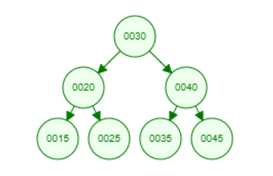
Practice Final Review - Question 11
Suppose you just wrote the search method for your BinarySearchTree implementation. Which set of 4-integer values should we search for to gain as much confidence in our algorithm?
10, 15, 20, 30
15, 25, 35, 45
15, 20, 30, 40
20, 30, 40, 50
25, 30, 40, 50
search (e)
Input: An element e
Description: Determines if e is in the tree
Return: True if e is in the tree; False if not

Slide 103
Practice Final Review - Question 11
Suppose you just wrote the search method for your BinarySearchTree implementation. Which set of 4-integer values should we search for to gain as much confidence in our algorithm?
10, 15, 20, 30
15, 25, 35, 45
15, 20, 30, 40
20, 30, 40, 50
25, 30, 40, 50
search (e)
Input: An element e
Description: Determines if e is in the tree
Return: True if e is in the tree; False if not

Slide 104
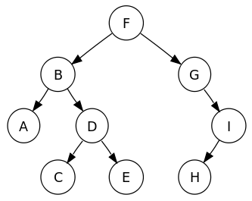
Practice Final Review - Question 12
width: maximal number of nodes on a path from one node in the tree to another
What is the width of this tree?
4
5
6
7

Slide 105
Practice Final Review - Question 12
width: maximal number of nodes on a path from one node in the tree to another
What is the width of this tree?
4
5
6
7

Slide 106
Practice Final Review - Question 12
How can we calculate the width of a Binary Tree?
Calculate the max height of the tree
Calculate the sum of the max number of nodes in the left and right subtree
Calculate the sum of the max height of the left and right subtree
Calculate the sum of the max number of children in the left and right subtree

Slide 107
Practice Final Review - Question 12
How can we calculate the width of a Binary Tree?
Calculate the max height of the tree
Calculate the sum of the max number of nodes in the left and right subtree
Calculate the sum of the max height of the left and right subtree
Calculate the sum of the max number of children in the left and right subtree

Slide 108
Practice Final Review - Question 13
We have a Set interface, which does not add element e if e is already in the Set. We also have a List interface, which adds all elements e to the List. We need to determine the number of unique email addresses we’ve received an email from. If we choose to use the Set interface rather than the List interface, did we choose the right interface?
Yes
No

Slide 109
Practice Final Review - Question 13
We have a Set interface, which does not add element e if e is already in the Set. We also have a List interface, which adds all elements e to the List. We need to determine the number of unique email addresses we’ve received an email from. If we choose to use the Set interface rather than the List interface, did we choose the right interface?
Yes - the Set interface cannot contain duplicates
No

